Slide 1
Migration FORGES/GIT « Idea »
Exemple : A350 CPIOM
Référence et Date de la présentation
28/06/2024

Slide 2
Stakeholders
Jean-François RENNESSON
ATA42 Integration Work Package Leader
Clément LE BAS
Project Leader Avionics Resources
Hamza BARHOURHE
Team Leader ATA42 MI
Notes:
Optionnelle

Slide 3
Distribution
Participants of the meeting and recipient of the document
Full Name | position | Present / Recipient
Jean-François RENNESSON | ATA42 Integration Work Package Leader | Present
Clément LE BAS | Project Leader Avionics Resources | Present
Hamza BARHOURHE | Team Leader ATA42 MI | Present

Slide 4
Summary
1.
4.
Analysis of solutions Vs problems
Contexte
2.
AS IS
3.
TO BE

Slide 5
1
Contexte

Slide 6
Contexte
1
Heavy process
  Too many baselines defined in the configuration management process)
  Un-understandable tree
  Processed not followed
  Some products not well managed in configuration
  Different process/documents depending on products / programs
Scripts with bugs
Impossible to have several branches
Obsolescence of Forges

Slide 7
2
AS IS

Slide 8
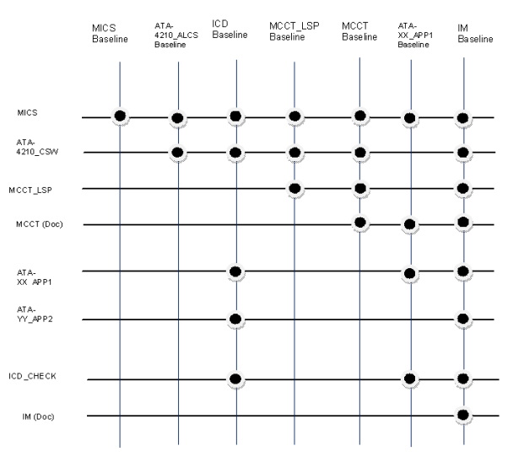
AS IS
2
Working Methodology in FORGES for CPIOM A350
Incovinient :
Too many baselines
Same documents archived in several baselines
Some directories and documents are already archived in several databases (e.g. ECM).

Slide 9
3
TO BE

Slide 10
TO BE
3
Solutions :
Too many baselines → One baseline will contain all
Same documents archived in several baselines → The documents and configuration will be archived once in a baseline.
Some directories and documents are already archived in several databases (e.g. ECM). → Stop archiving all documents

Slide 11
TO BE
3
One Baseline
A350
BATCH xx
LABEL Number « LXXX »
MICS_L
Manual modifications to each batch
Label change by batch modification
Only changes what have been changed in a batch, without the need to update everything.
Great Label Management “One Label for all”
MICS
MICS_F
MCCT_S
MCCT
MCCT_DOCS
IM-DOCS
IM-CID
ATAXX DDP
Load generation script.sh/py
QC/LTR
README
Batch number
Numero de label

Slide 12
4
Analysis of solutions Vs problems

Slide 13
Analysis of solutions Vs problems
4
Heavy process
  Too many baselines defined in the configuration management process) → One Baseline contains all
  Un-understandable tree →Tree management will be per Batch which is more understandable
  Processed not followed →The process will be easier and can be performed quickly
  Some products not well managed in configuration →This method will manage all the product
  Different process/documents depending on products / programs →We could use the same methodology for other products/programs
Scripts with bugs →The load generation script will be included in branche
Impossible to have several branches →No need to have several branches for this method
Notes:
Action macro sur le périmètre ou actions globales

Slide 14
Thank You

Slide 15
Imagine the world
of tomorrow with us

